Slide 1





Fusion Prototypic Neutron Source (FPNS)
Yash Pise
Varun Chinchalkar
Vidisha Bardekar
Nikhil Bhuta
Abhijeet Patil

Slide 2
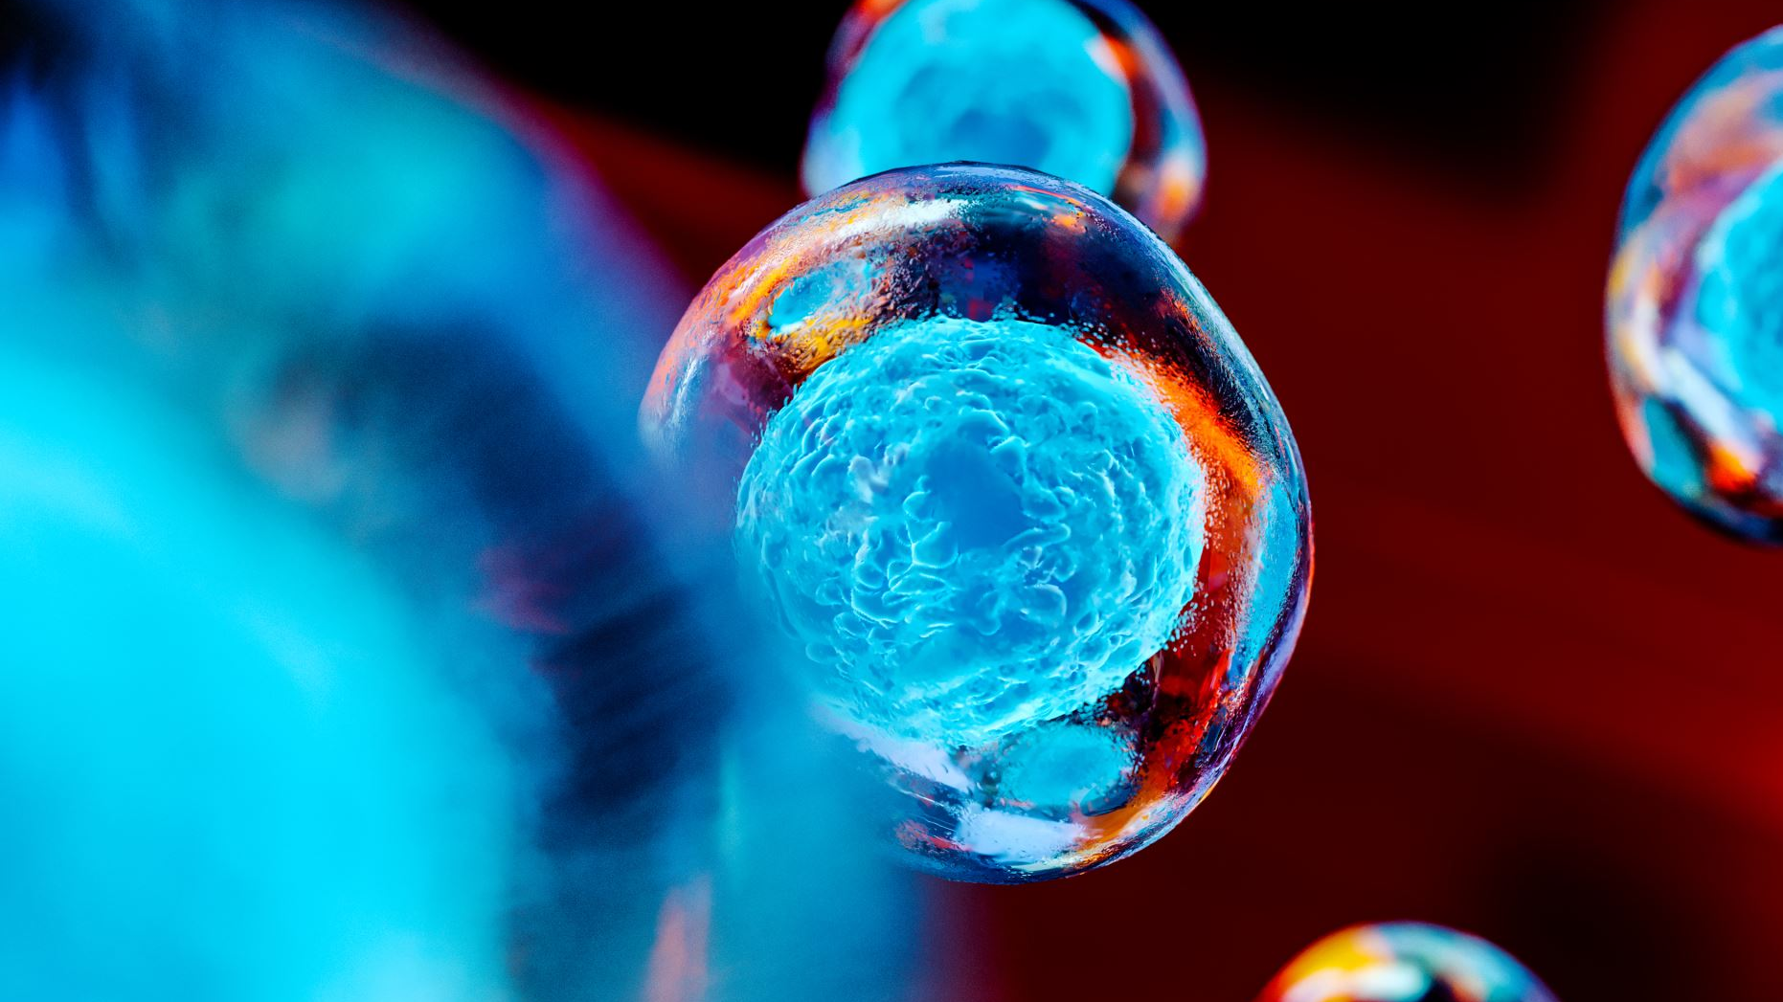
Introduction
To realize fusion energy, it is essential to build a neutron source that can replicate the extreme conditions of fusion energy devices, including atomic displacements, transmutation production, and high operating temperatures
There are still fundamental knowledge gaps regarding the materials used in fusion energy devices
Fusion Prototypic Neutron Source (FPNS), could be constructed soon at a moderate cost
A FPNS will help build the scientific foundation required to enable design of a next step fusion device

Slide 3
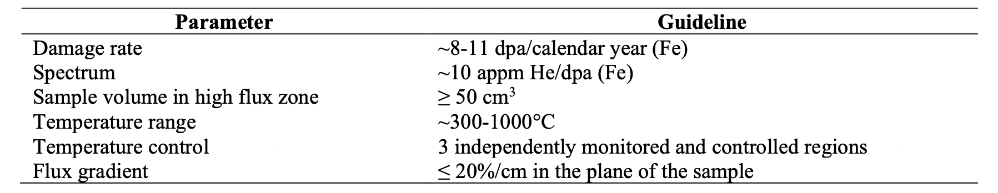
Design Requirements
The primary mission of FPNS is to establish the materials science knowledge base to understand materials degradation in a D-T fusion environment. To achieve these goals a set of key parameters were considered.

Slide 4
Cost Estimate
Ion Source Systems: High intensity ion sources are considered in various stages of design, construction, operation of FPNS system
Cost: $7M
Accelerator Systems :Several past accelerator system design studies were reviewed, and an analysis of alternatives was completed to assess the range of accelerator parameters and accelerating structure types that can potentially meet the requirements. Alternatives were used to develop two options for consideration based on a common set of accelerator system parameters
Cost: $75M
Lithium Target Systems: The members of the group performed a bottom-up estimate for the lithium target system based upon designs that have been published previously. The design includes three sets of master-slave manipulators, three shield windows, a bridge crane with a servo manipulator, a 30-ton bridge crane for handling large components, a beam dump with a vault-like facility, and resources to detail the facility and integrate it with the building.
Cost: $33M
Conventional Facilities: Conventional facilities includes the site preparation; buildings that contain the accelerator and target system; electric power for the system and the need for a new electrical substation; heat exchangers to remove the waste heat from the accelerator and the target; fees for the general contractor who will execute this work.
Cost: $173M
Contingency and cost range: This is the cost range for a D-Li stripping version of FPNS
Cost: $471M-$1179M

Slide 5
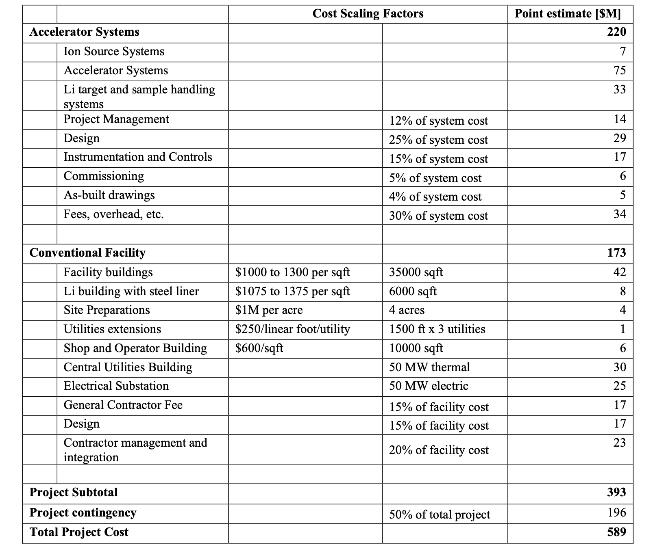
Detailed Cost Estimate

Slide 6
Preliminary cost and TRL estimate of the ion source and LEBT for the Fusion Prototypic Neutron Source

Slide 7
Abstract
The development of a fusion prototypic neutron source (FPNS) to evaluate materials exposed to fusion reactor environments has been a long-standing goal of the fusion community
It explains that D-T fusion plasmas emit intense fluxes of ~14 MeV neutrons which create unique damage profiles within structural wall materials that cannot be studied using neutrons from fission reactors nor conventional spallation neutron sources
A dedicated FPNS could be used to simultaneously irradiate many candidate sample materials with the correct neutron energies having a flux intensity sufficiently high to allow material evaluations to occur much more rapidly than in actual fusion reactors.+
The cost estimate was based on the cost of the ion source and LEBT delivered to the ESS (European Spallation Neutron Source). It includes labor and materials needed for design integration, construction, installation and commissioning of the system while neglecting licensing costs of the design as well as the cost of implementing beam diagnostics and controls hard- and software

Slide 8
CONCEPT OF THE D-Li FUSION NEUTRON FACILITY AND REQUIREMENTS
Materials used in fusion devices have received comparatively little attention than fission, despite their critical importance
The energy spectrum of neutrons emitted from a fission reactor is 2 MeV while that emitted from D-T fusion plasmas is 14 MeV thereby inducing unprecedented levels of dislocation damage (100-200 dpa) to materials as well as significant transmuted He production
To produce neutrons with intensities that of a fusion reactor, an accelerator-based approach is under consideration which utilizes the Li reaction as a source of neutrons
CW beams of deuterons (~125 mA) can be accelerated to relevant energies by an RFQ and a 40 MeV LINAC and then collided with Li to produce sufficiently intense neutron beams
A $1B International Fusion Materials Irradiation Facility project is now being constructed and commissioned in Rokkasho, Japan

Slide 9
CONCEPT OF THE D-Li FUSION NEUTRON FACILITY AND REQUIREMENTS
Recently, the US Department of Energy (DOE) Office of Fusion Energy Sciences (FES) has asked ORNL to provide an estimated cost, timeframe and TRL (Technical Readiness Level) of constructing a scaled down version of IFMIF facility, presumably in the United States
The proposed facility will require the ion source and LEBT parameters to be essentially the same as IFMIF: ~140 mA of D+ CW/DC extracted and transported through the LEBT at ~100 keV with an RMS normalized emittance ε < 0.25 π mm mrad). The beam from the RFQ that will be transported through the LINAC to target would be ~125 mA

Slide 10
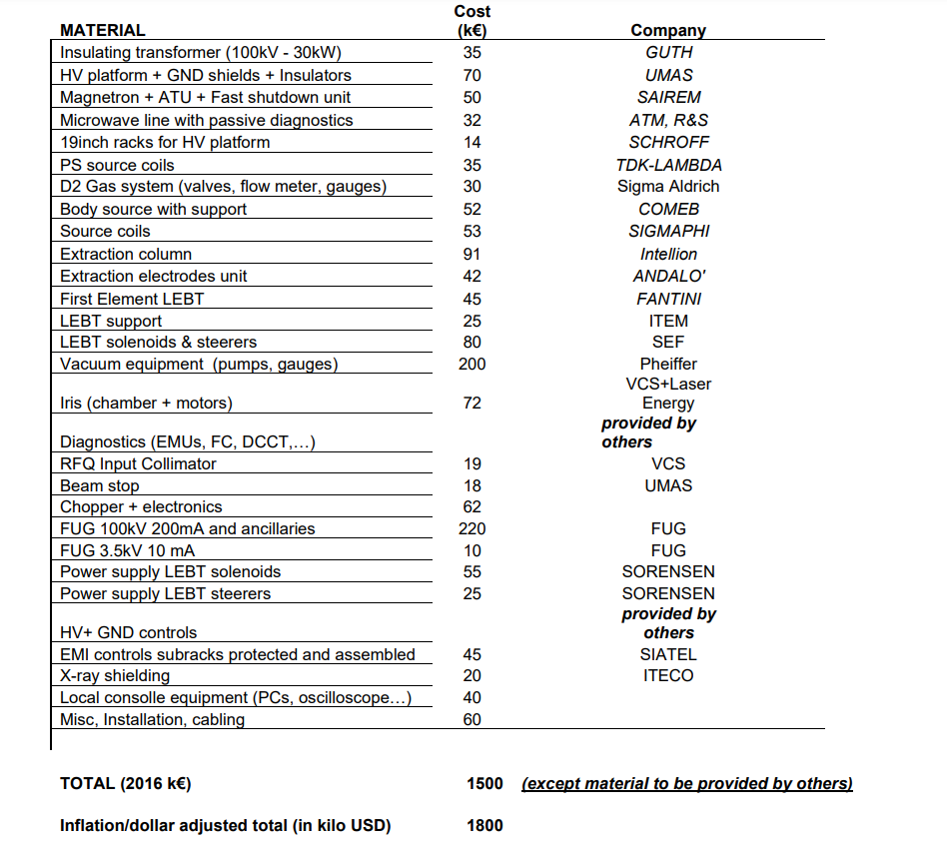
COST ESTIMATE BASED ON THE EUROPEAN SPALLATION SOURCE ION SOURCE / LEBT SYSTEM

Slide 11
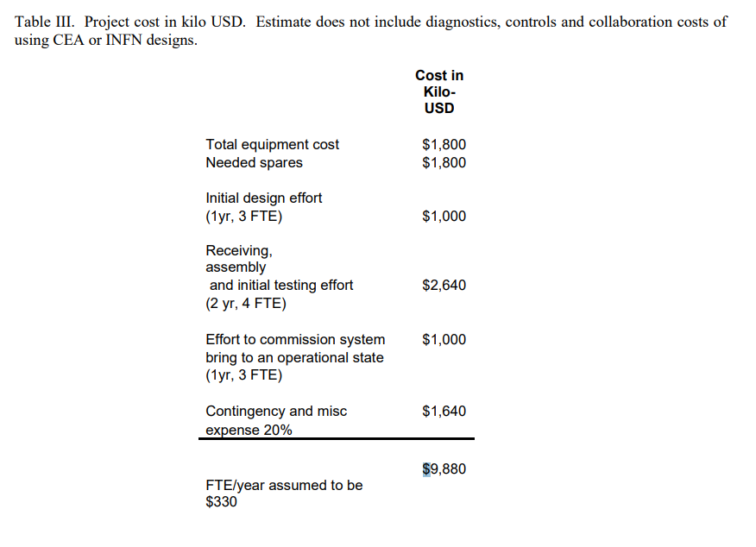

Slide 12
ESTIMATED TRL LEVEL OF THE D-LI FUSION NEUTRON FACILITY ION SOURCE / LEBT
The technical Readiness Level TRL is defined as follows:
TRL 1 - When a technology is at TRL 1, the scientific research is just beginning, and those results are being used to plan future research and development. Basic principles are observed and reported.
TRL 2 - TRL 2 occurs once the basic principles have been studied and those results can be applied to practical applications. TRL 2 technology is very speculative, with little to no experimental proof of concept for the technology. The technology concept and/or application have been formulated.
TRL 3 - When active research and design begin, a technology is elevated to TRL 3. Generally, both analytical and laboratory studies are required at this level to see if a technology is viable and ready to proceed further through the development process. A proof-of-concept model is developed.
TRL 4 – Component or breadboard validation in the laboratory environment.
TRL 5 - TRL 5 is a continuation of TRL 4. Component or breadboard validation in a relevant environment.
TRL 6 – System/subsystem model or prototype demonstration in a relevant environment.
TRL 7 - Working model or prototype demonstrated in a relevant operational environment.
TRL 8 – Actual system completed and qualified through test and demonstration.
TRL 9 – Actual system proven through successful mission operations.

Slide 13

Current state for High intensity sources for High energy accelerators
The CRNL team demonstrated that an over-dense plasma may be achieved by axially injecting 1 kW of microwaves into a tiny plasma chamber with an axial magnetic field.
This arrangement was proved to be capable of delivering 90% proton fractions with CW current densities of 120 mA/cm2, and it will be the basis for all high-intensity proton sources utilized for high energy accelerator injection during the next 30 years.
Since then, a range of other projects have used proton sources and LEBTs mainly provided by CEA or INFN. This source, together with LEBT and an RFQ, will eventually serve as one of the IFMIF project's two accelerators.
INFN has produced a very comparable version of the CEA / IFMIF source and LEBT to be utilized as the H+ injector for the ESS in parallel with the IFMIF/CEA project.
Various variants of these sources have been tested in pulsed and CW/DC modes, yielding H+/D+ beam currents ranging from 50 to 130 mA, as well as dependable operation and adequate beam emittance.
This data will be used as our rough cost estimate of implementing an ion source and LEBT in the proposed FPNS.

Slide 14
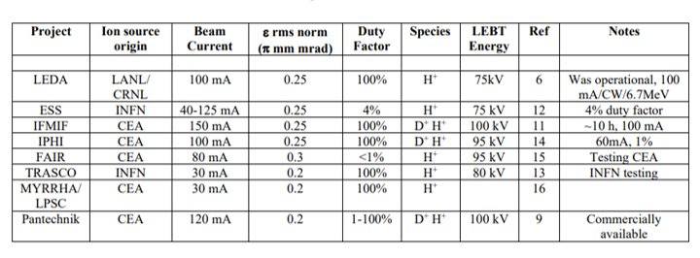
Different Projects and their Ion source Origin comparisons

Slide 15
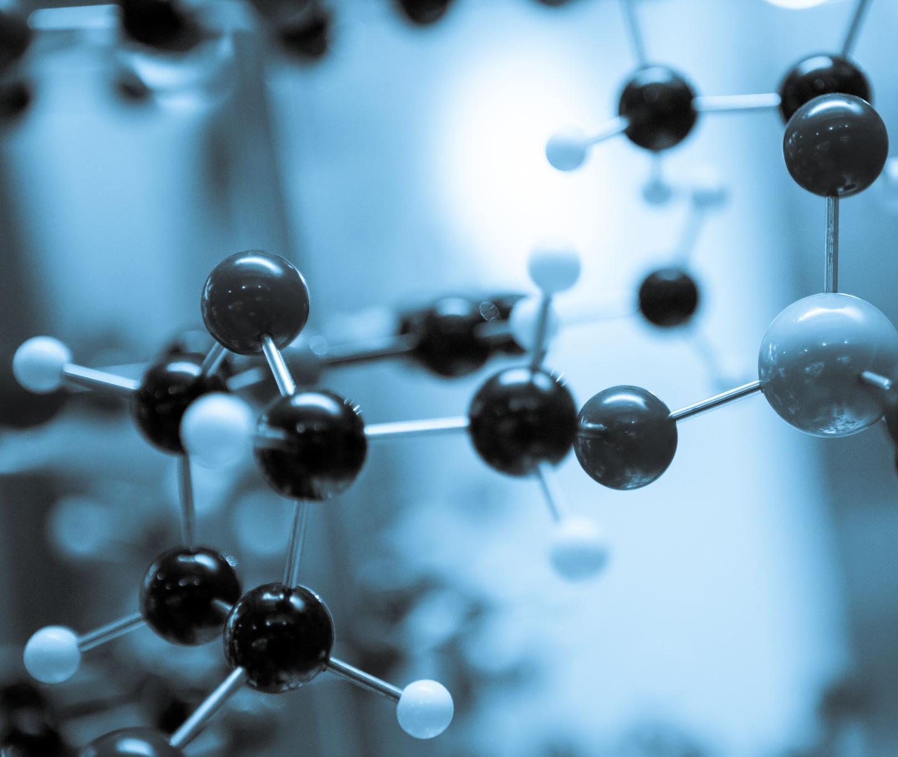
ORNL D-Li Fusion Neutron Facility

Slide 16
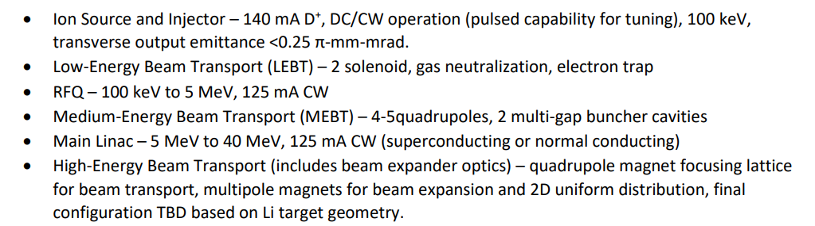
Accelerator Systems alternatives and Cost Report
An analysis of alternatives completed to assess the range of accelerator parameters and accelerating structure types that can potentially meet the requirements of a 125- mA, 40-MeV, D-Li Fusion Neutron Facility
Results of the analysis of alternatives were used to develop two options for consideration based on a common set of accelerator system parameters:

Slide 17
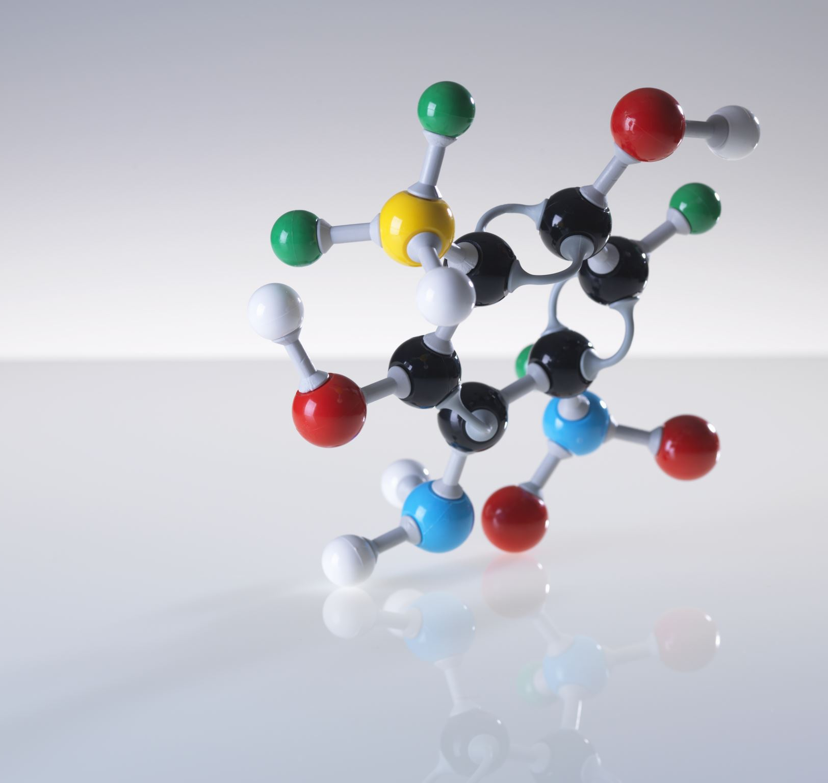
Abstract
In 2018 a community workshop was held by the US fusion materials community to assess the value of a Fusion Prototypic Neutron Source (FPNS)
It was focused on understanding material degradation in a fusion environment
The workshop concluded that, moderate cost FPNS would advance the current state of scientific understanding of materials degradation in the intense fusion neutron environment and that such a facility would be an asset to the US fusion program
The primary goal of building a FPNS is to provide a source of neutrons at relevant energies and fluxes in a test station in the next 5-10 years, in a cost-effective manner
Options such as 40 MeV D-Li Fusion Neutron are being explored

Slide 18
Ion Source and Injector reproduces the 40-MeV IFMIF-EVEDA-LIPAc design based on an RFQ and a SCRF HWR-based main linac
Low-Energy Beam Transport (LEBT) is an alternative 40-MeV design based on an RFQ followed by a normal-conducting (NC) DTL main linac
Both of them meet the accelerator requirements
Ion Source and Injector is complex to build while, LEBT is simple but will be more costly as it needs additional electrical power
Technology readiness levels (TRLs) of RFQ has been recently demonstrated at the prototype level in a relevant operational environment for the proposed application
The TRL level range from TRL 6 to TRL 7
Cost scaling factors were developed and used to estimate the accelerator system costs
Both Ion Source and Injector and LEBT have a similar cost estimate
Ion Source and Injector costs $74 Million and LEBT costs $70 Million
These include only the major accelerator system
Total Project cost estimate goes upto $100 million which includes design, management and other project costs

Slide 19
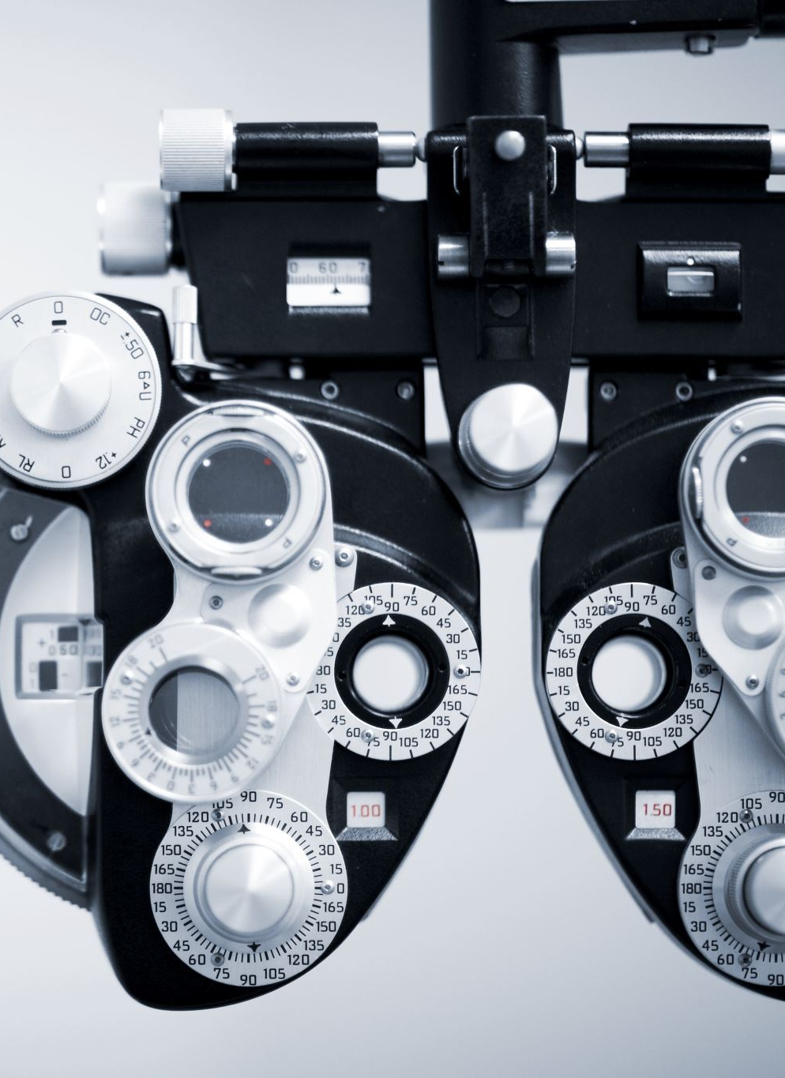
Analysis of Alternative (AOA)
Several accelerator designs were proposed for D-Li fusion neutron facility to generate 14-MeV neutrons.
Design includes both normal-conducting and superconducting main accelerators following RFQ accelerator for initial acceleration of D beam.
Major goal is to develop a cost-effective solution that also meets the performance requirement for moderate-energy D-Li fusion.
initial designs proposed at LANL including modification and reuse of the Low-Energy Demonstration Accelerator (LEDA), an early design agreed to by consensus of the fusion and accelerator communities (FMIF), and the presently accepted IFMIF design.

Slide 20
LANL High-Flux Accelerator-Based Neutron Source for Fusion Materials and Technology Testing (1989)
Workshop in San Diego, CA
based on the Fusion Materials Irradiation Test (FMIT)
improvements incorporated since FMIT include:
a. A better analytical understanding
b. Use of ramped linac accelerating gradients
c. Use of permanent-magnet quadrupoles
d. Use of higher RF frequencies to reduce beam emittance growth
e. Use of improved beam-dynamics and high-order optics codes for simulating high-current beams and for controlling the spatial intensity of the beam

Slide 21
LANL High-Flux Accelerator-Based Neutron Source for Fusion Materials and Technology Testing (1989)
The 1989 report highlights several accelerator technical issues:
a. Beam losses in the accelerator and HEBT – activation levels need to allow for hands-on maintenance
b. Accelerator Efficiency – RF costs dominant overall accelerator costs.
c. Beam Energy Variability – Design uses a DTL as the main accelerating structure.
Cost information was provided, and the estimated cost of the full fusion materials and technology facility is $352M (2019$) based on escalating the cited costs in Ref. 6 by 3% per year.
Estimated cost of the accelerator system is $85M (2019$).

Slide 22
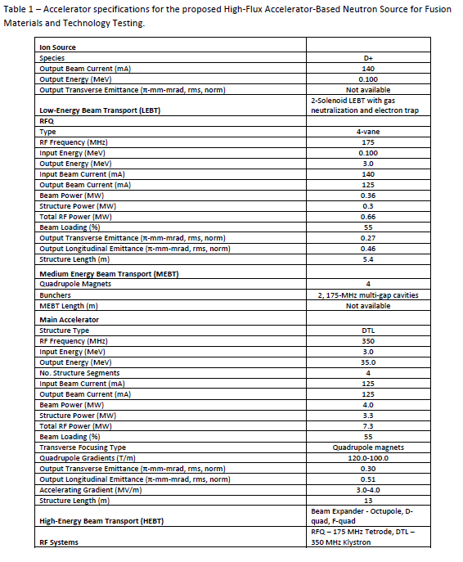












Slide 23
Fusion Materials Irradiation Facility (FMIF 1992)
accelerator design specifications for a 14-MeV fusion materials irradiation facility capable of providing a neutron flux equivalent to a neutron wall loading of 2 MW/m2 to a 1-liter irradiation volume.
specifications proposed are very similar to those proposed by LANL in 1989 with a few differences.
assumes 100-keV injection into a 2-MeV 175-MHz RFQ followed by a hybrid NC-SCRF 40-MeV, 350-MHz DTL.
DTL design uses four tanks that allow energy variations in discrete steps of the final output beam energy
DTL is divided into two major sections: Section 1 is a NC 350-MHz DTL accelerating the beam to 8 MeV. Section 2 contains three 350-MHz SCRF DTL sections accelerating the beam to the final 40-MeV energy.
The accelerator design specifications presented are not supported by beam physics or engineering design calculations.

Slide 24
